Slide 2


Slide 3
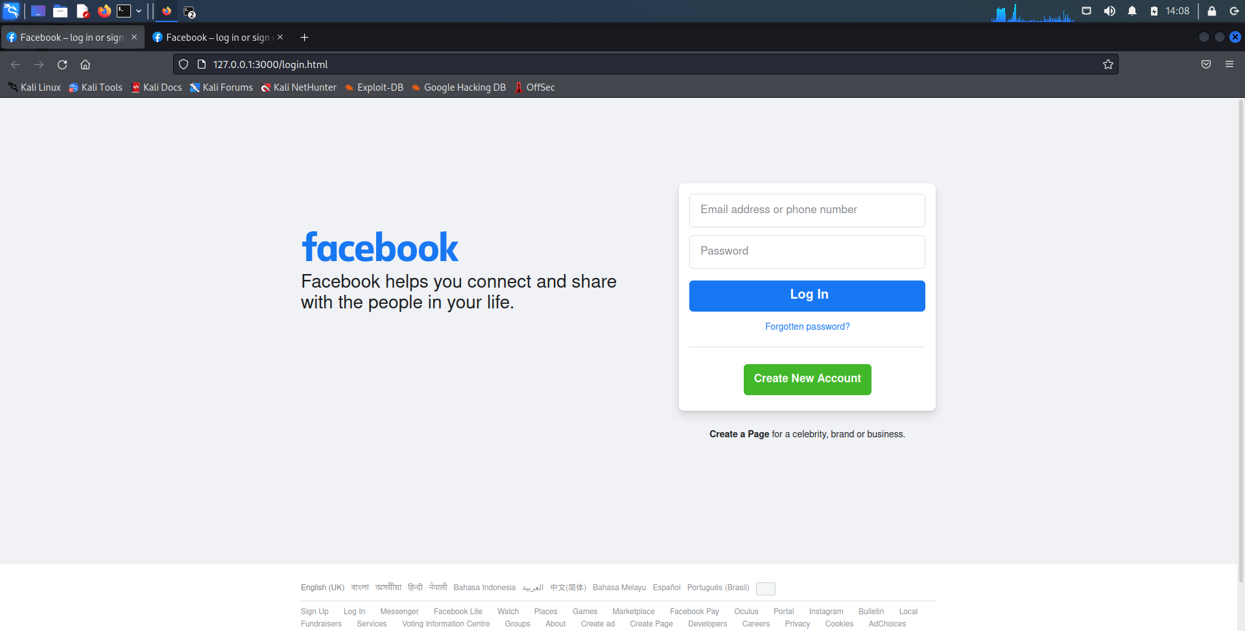
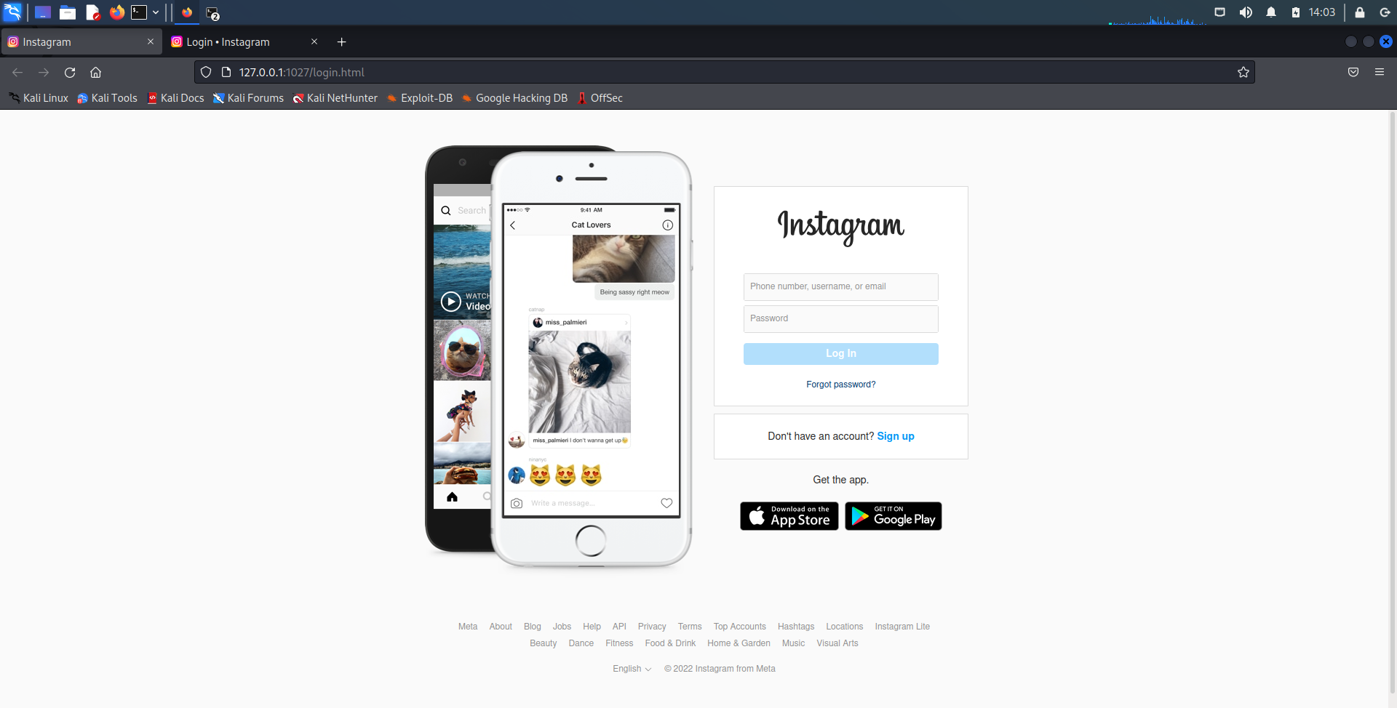
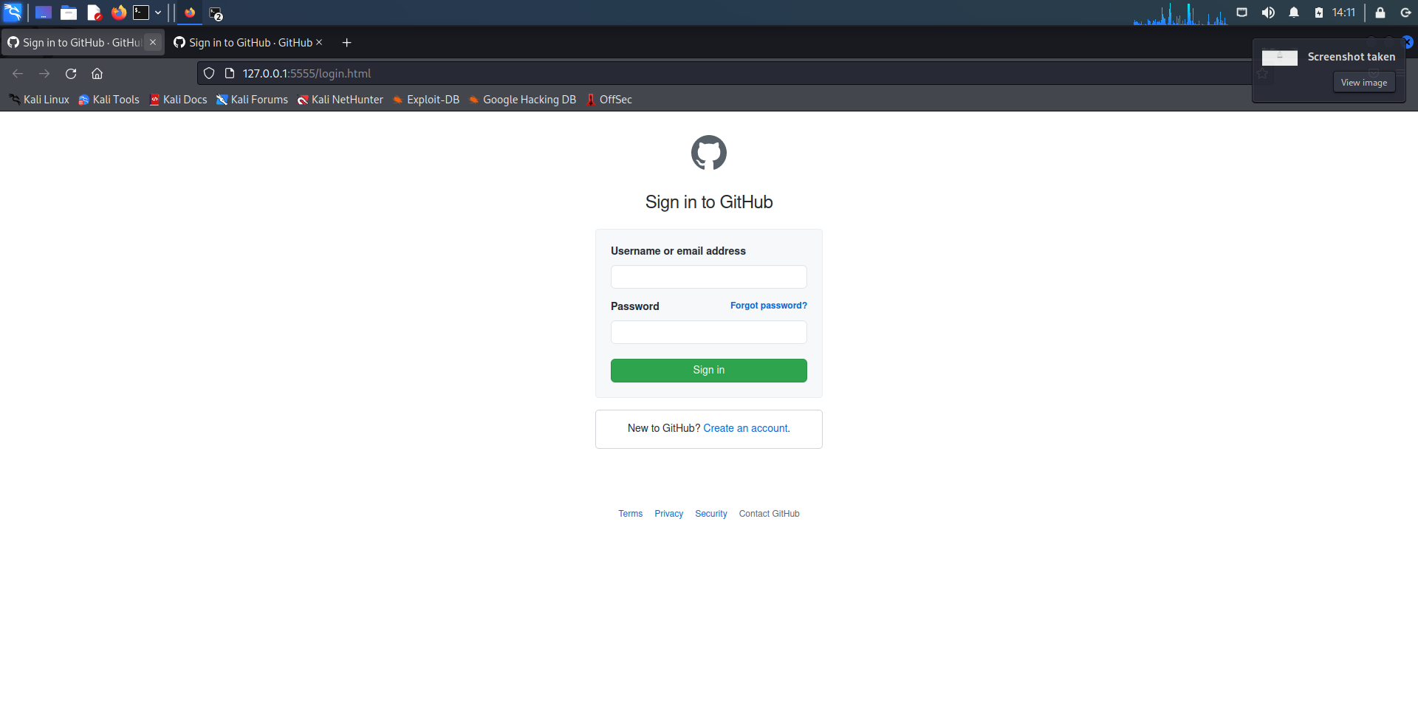

Slide 7
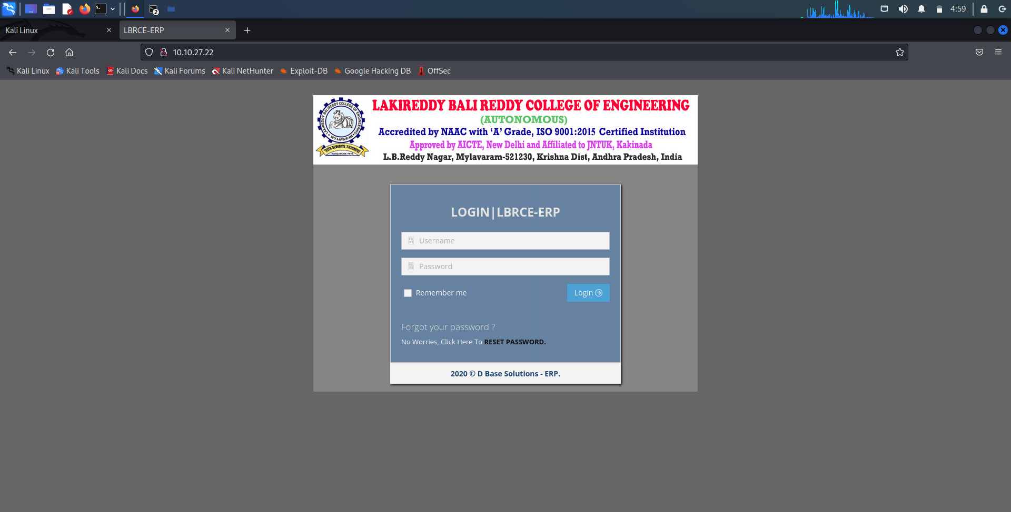

Slide 8
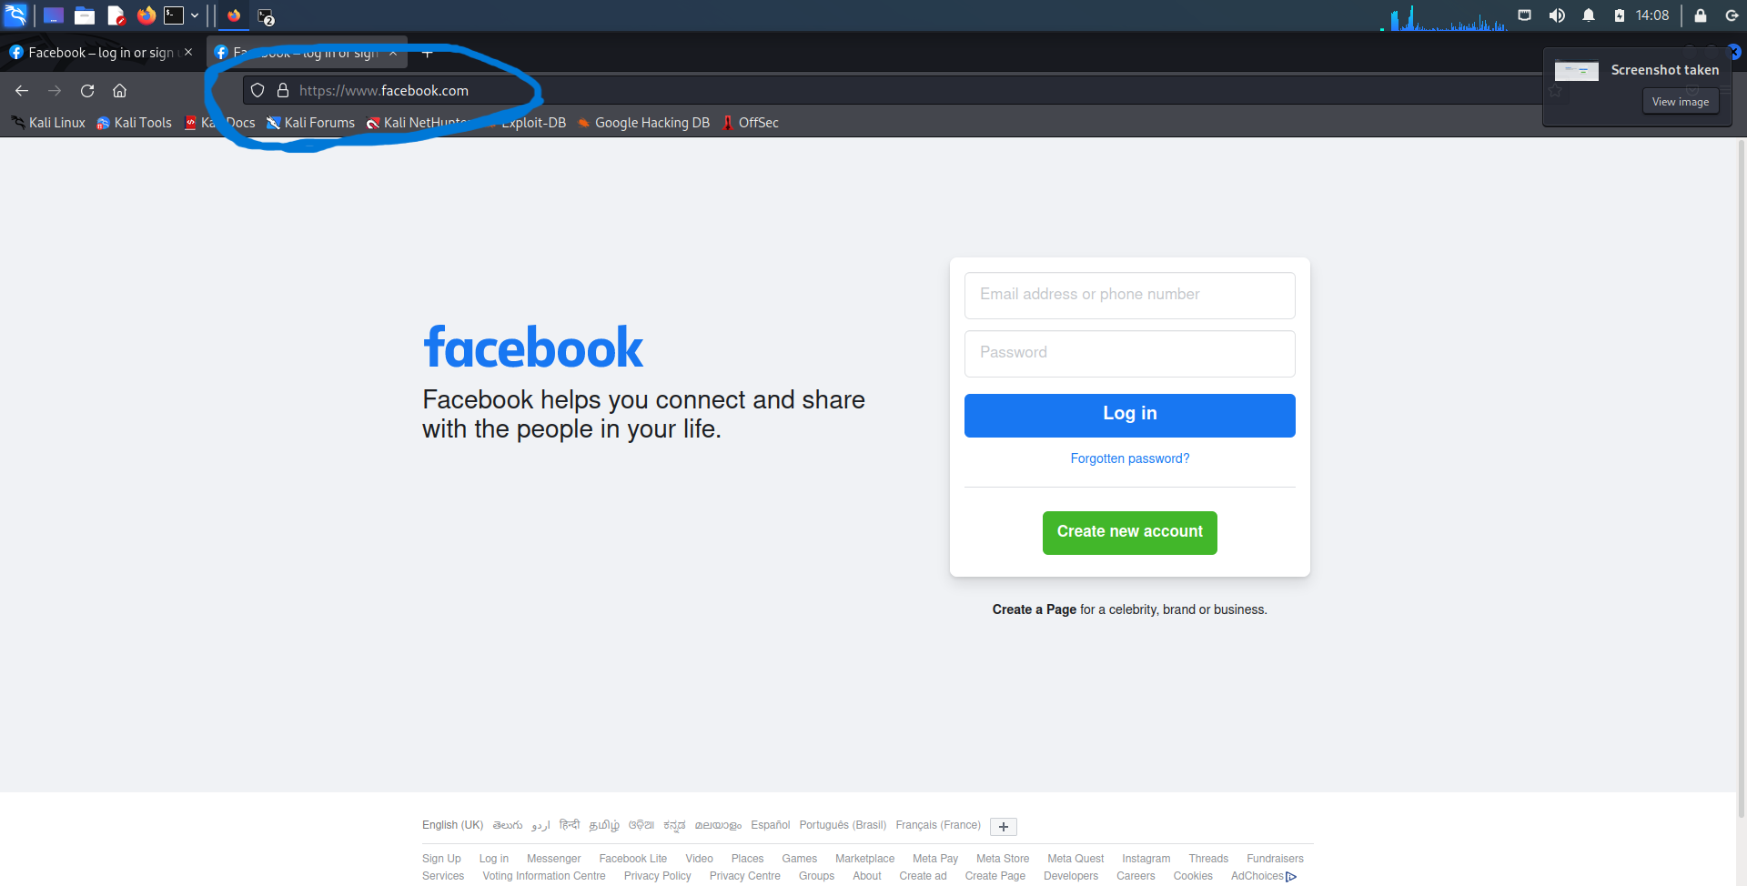

Slide 9
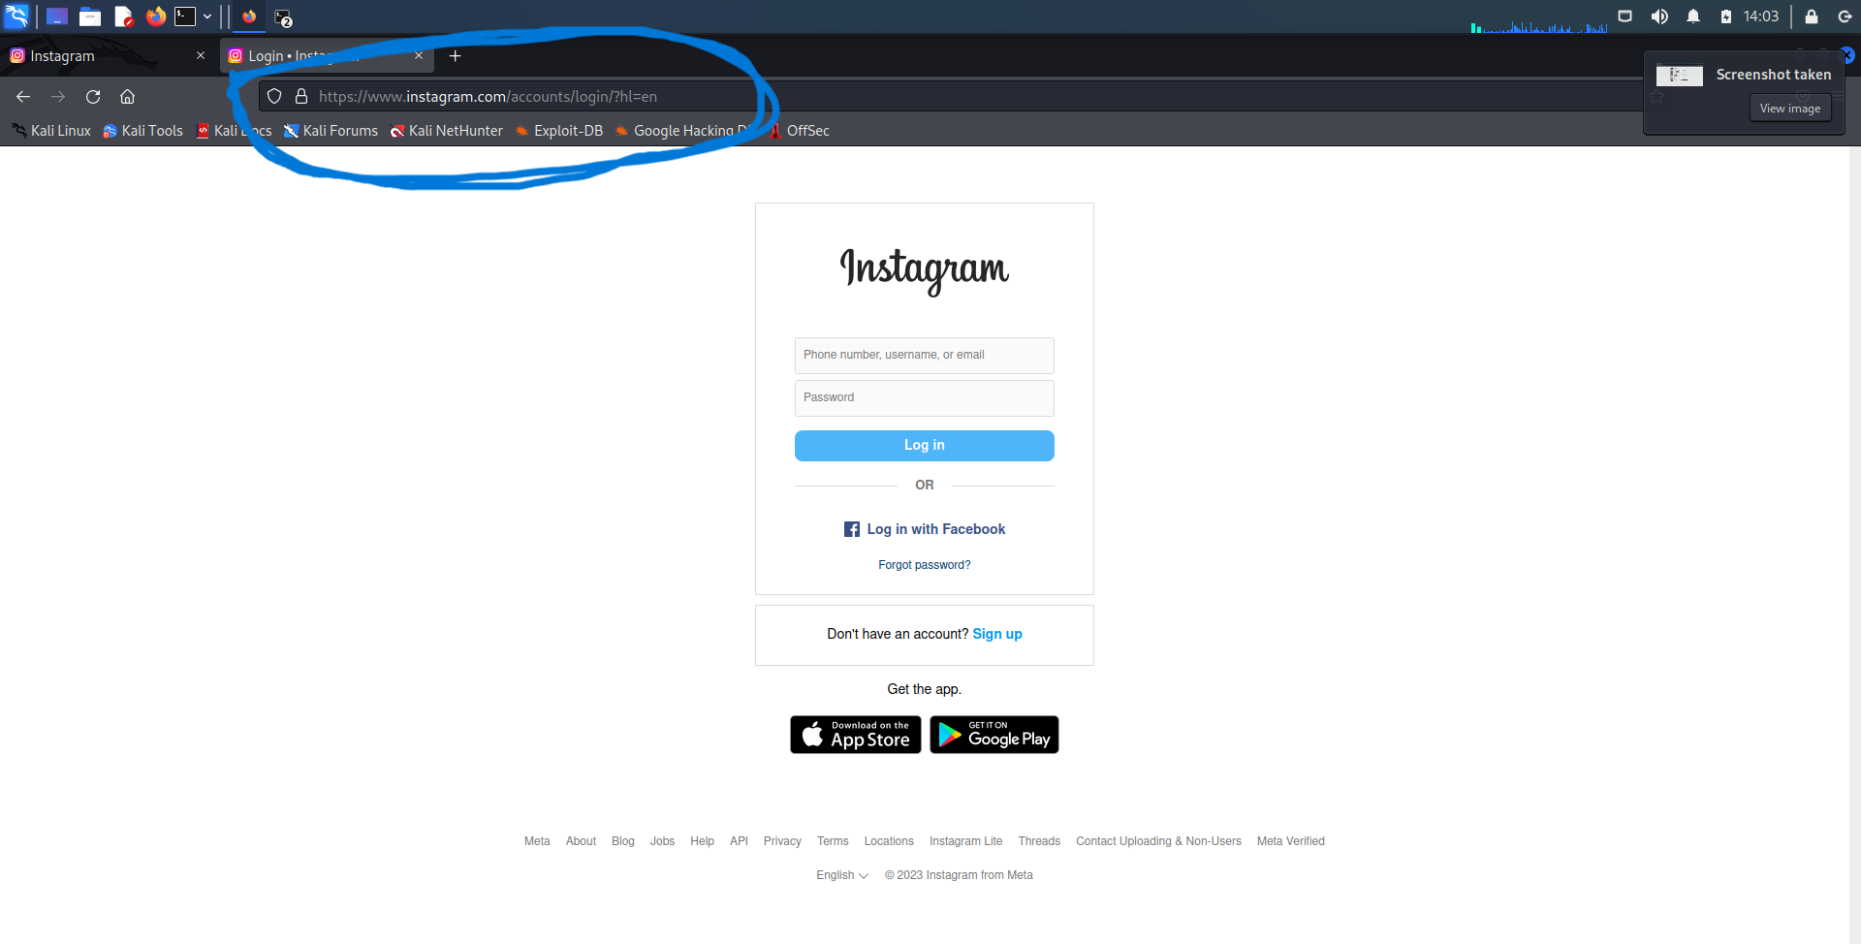

Slide 10
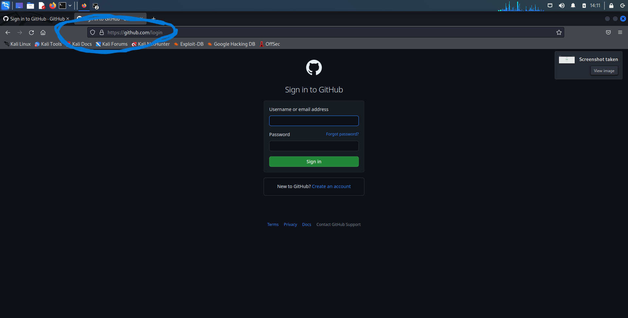

Slide 11
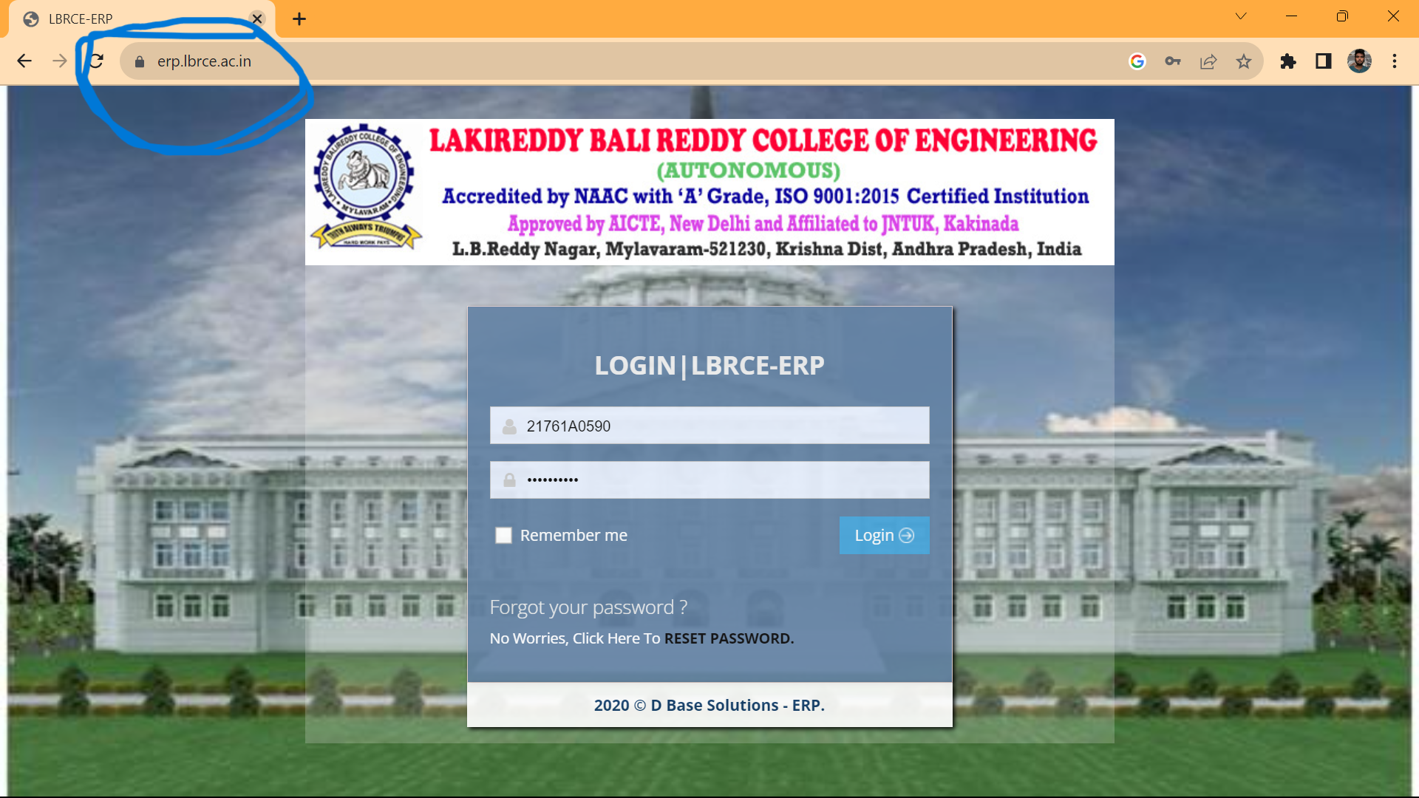
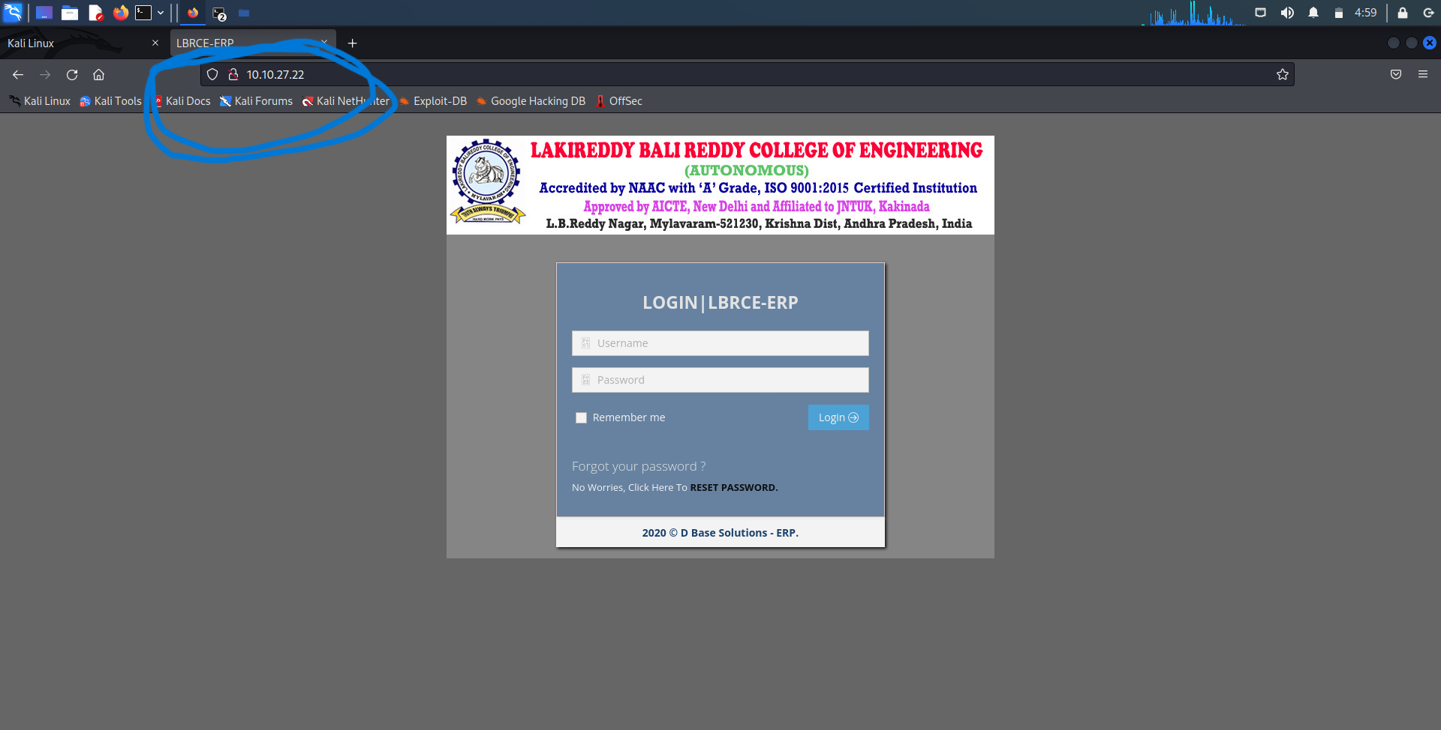

Slide 12
R
T
S
C
A
T
A
B

Slide 13


Phishing
Threat to individuals and organizations
Feel of genuine domains
Research aims to reduce risk
Provide defense against tactics employed by cyber criminals
Maintains high level of accuracy to identify phishing domains

Slide 14
C
V
J
I
O
E
T
E
B

Slide 15
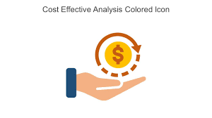



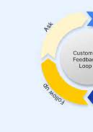

objectives

Slide 16
Accurate Phishing Detection
Develop AI/ML models that can accurately identify phishing domains, even when they closely mimic the appearance of legitimate domains. The primary goal is to minimize false positives and false negatives in the detection process.
objectives

Slide 17
User Awareness and Education
Implement user education and awareness programs within the system. Alert users when they encounter potentially malicious domains and provide educational materials to help them recognize phishing attempts.
objectives

Slide 18
Timely Alerts
Generate timely alerts and notifications to security teams or individuals when a phishing domain is detected, allowing for swift action and incident response.
objectives

Slide 19
Multi Modal Analysis
Integrate various techniques, including machine learning, natural language processing, behavioral analysis, and domain-related features, to provide a comprehensive assessment of domain authenticity
objectives

Slide 20
Cost Effective
Design the system to be cost-effective, considering factors such as computational resources, data storage, and maintenance.
objectives

Slide 21
Y
O
L
G
T
O
M
H
D
O
E

Slide 22


Data Collection
Data Preprocessing
Phishing Domain Dataset: A comprehensive dataset of known phishing domains is collected from various sources, including public repositories and threat intelligence feeds.
Legitimate Domain Dataset: A dataset of legitimate domains is obtained to provide a baseline for comparison. Additional Data Sources: Features such as SSL certificates, DNS records, WHOIS information, and HTML content are gathered to create a robust dataset.

Slide 23


Feature Engineering
Feature Selection
Feature Selection Use techniques like Mutual Information, Chi-squared, or correlation analysis to select the most relevant features. Balance the dataset to mitigate class imbalance issues.

Slide 24
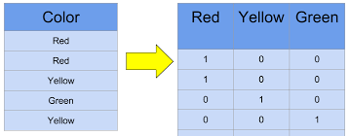
Apply techniques like TF-IDF, word embeddings, and one-hot encoding to transform textbased features
Normalize numerical features to bring them to a consistent scale.
Feature Transformation
Feature Engineering

Slide 25
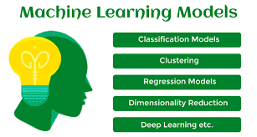
Machine Learning Models
Model Selection
Experiment with various ML algorithms, including Random Forest, Support Vector Machines, Gradient Boosting, and deep learning models like Convolutional Neural Networks (CNNs) and Recurrent Neural Networks (RNNs).

Slide 26
Machine Learning Models
Model Training
Split the dataset into training, validation, and testing sets.
Train models on the training data and fine-tune hyperparameters using the validation set. Employ techniques like cross-validation to ensure robust model performance.
Model Evaluation Evaluate models using metrics such as accuracy, precision, recall, F1-score, and ROC AUC. Conduct a thorough analysis of false positives and false negatives to refine model

Slide 27
Develop mechanisms to monitor user interactions with domains. Detect unusual behaviors, such as rapid clicks, form submissions, or deviations from typical user interactions.
Behavioral Analysis
User interaction monitoring

Slide 28

Alerts & Reports
Alert generation
Malcious Domain
Develop an alerting system to trigger alerts when a potentially malicious domain is detected.
Integrate alerts
Integrate alerts into existing security information and event management (SIEM) systems for streamlined response.

Slide 29
L
I
N
C
N
O
U
S
O
C

Slide 30

Research stands safeguard to cyber threats
Don’t be a cyber victim
Always check domain names
Don’t click on unwanted links
Don’t confuse on phishing domains

